Slide 1
ECE 313: PROBABILITY WITH ENGINEERING APPLICATIONS
Fall 2023
Prof. Eric Chitambar
Lecture 24

Slide 2





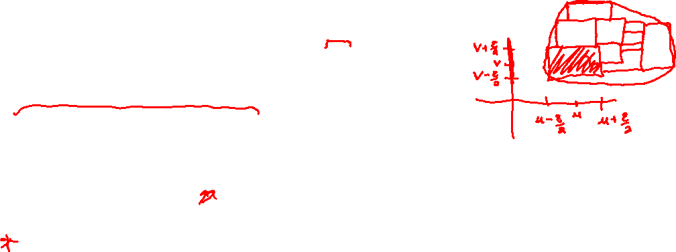
The Joint Probability Density Function (pdf)

Slide 3



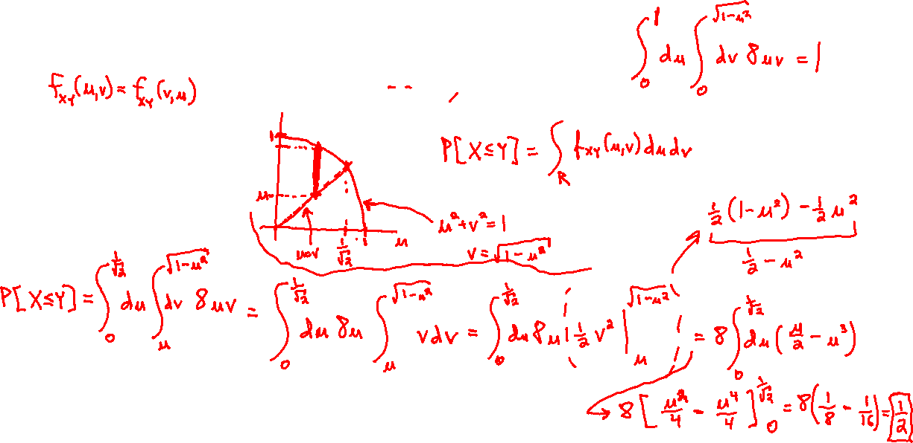
The Joint Probability Density Function (pdf)

Slide 4
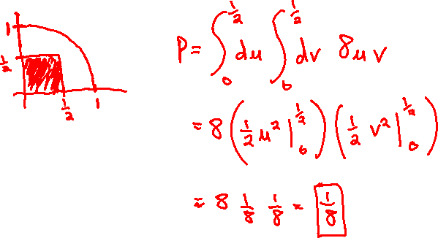
The Joint Probability Density Function (pdf)

Slide 5


The Joint Probability Density Function (pdf)

Slide 6
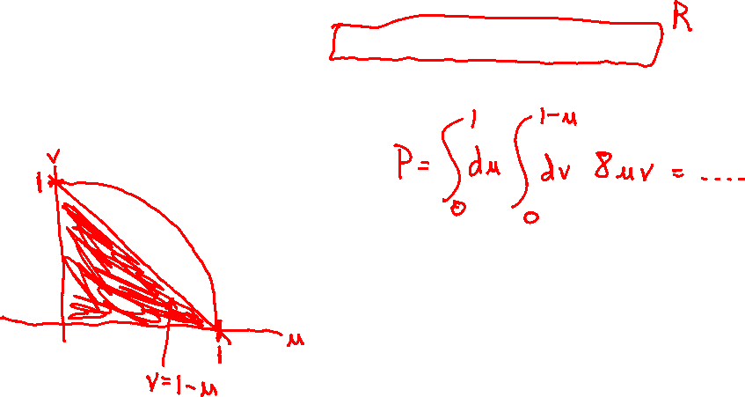
The Joint Probability Density Function (pdf)

Slide 7

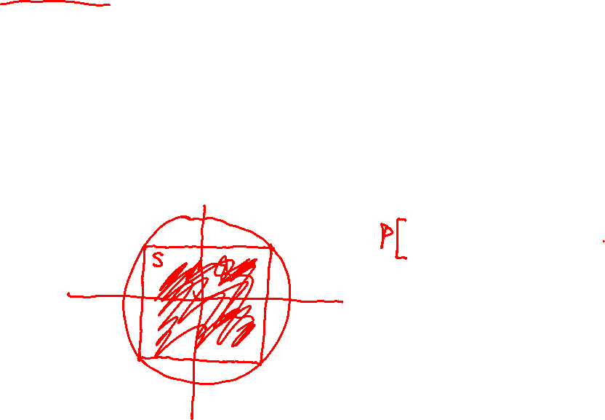
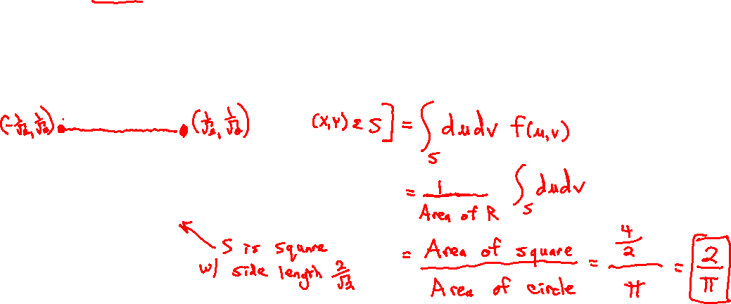
Uniform Distribution

